Slide 1
Project Alpha
Audrey, Kevin, Philip, Wassim

Slide 2
Language Requirements
HTML
MySQL
JavaScript
PHP
But none of us knew PHP…
We started with what we did know

Slide 3
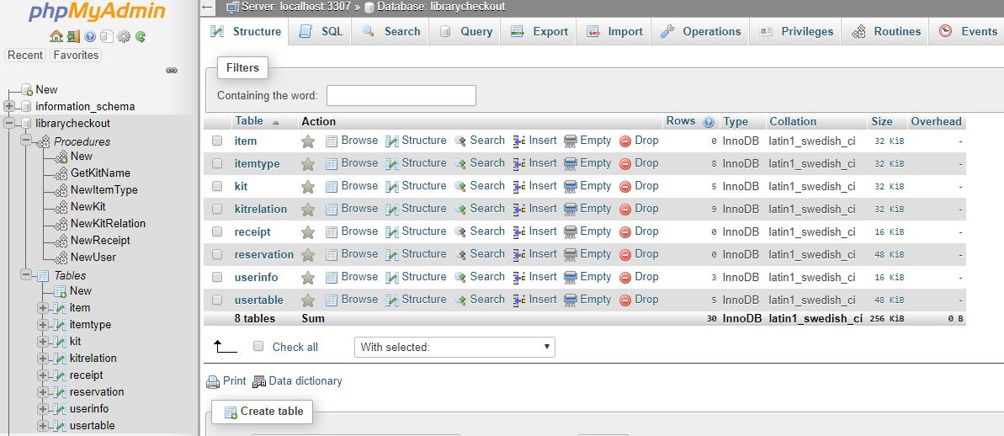
MySQL Database

Slide 4
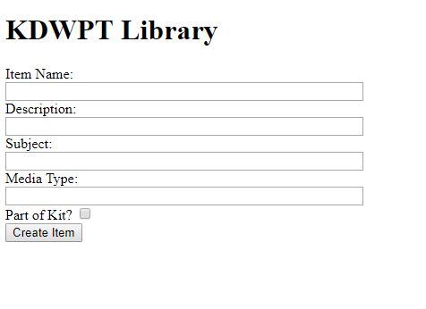
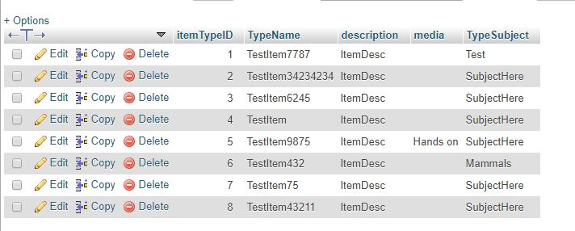
Creating Items
Now we need PHP

Slide 5
Learning PHP
What we’ve learned:
@ is your friend when you finish, not when you start
Echo early, echo often
Don’t just return an error: number it.
Everything. Will. Break.
Be creative in testing

Slide 6
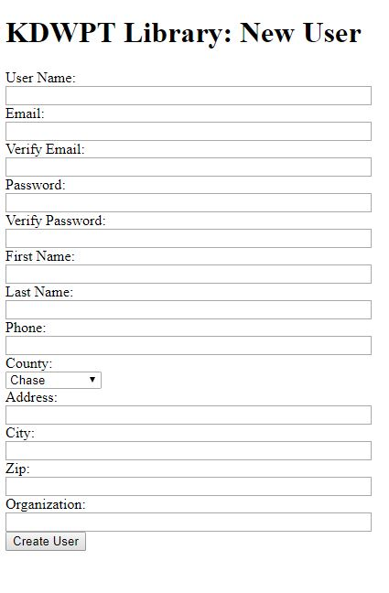
Creating New Users
One Form
Two Tables
105 Counties

Slide 7
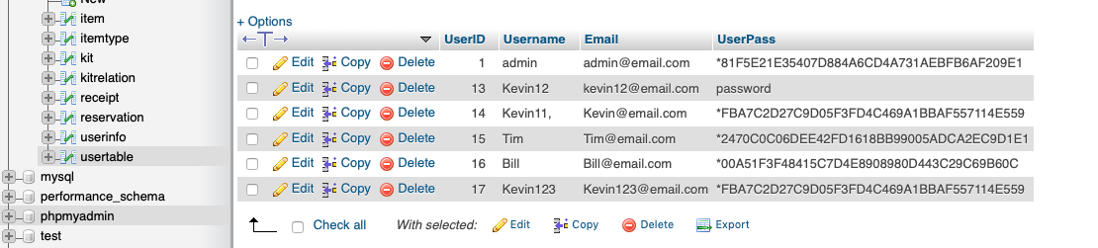
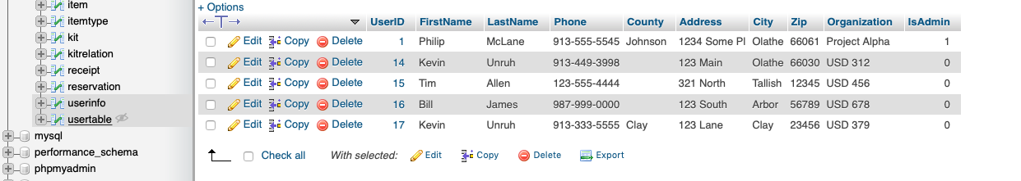
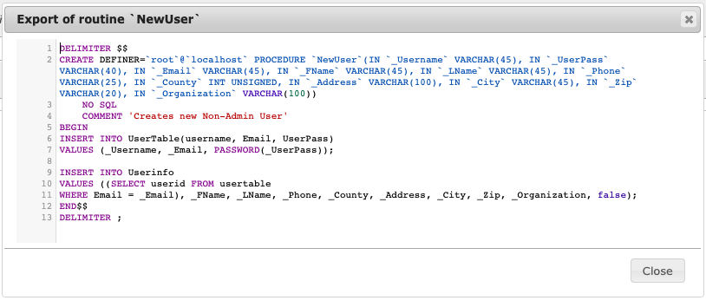

Slide 8
What’s Next
Login Page
Database Selection
Item Selection
Verify Selection (are you sure?)(really sure?)(ok)
Summary

